Slide 1


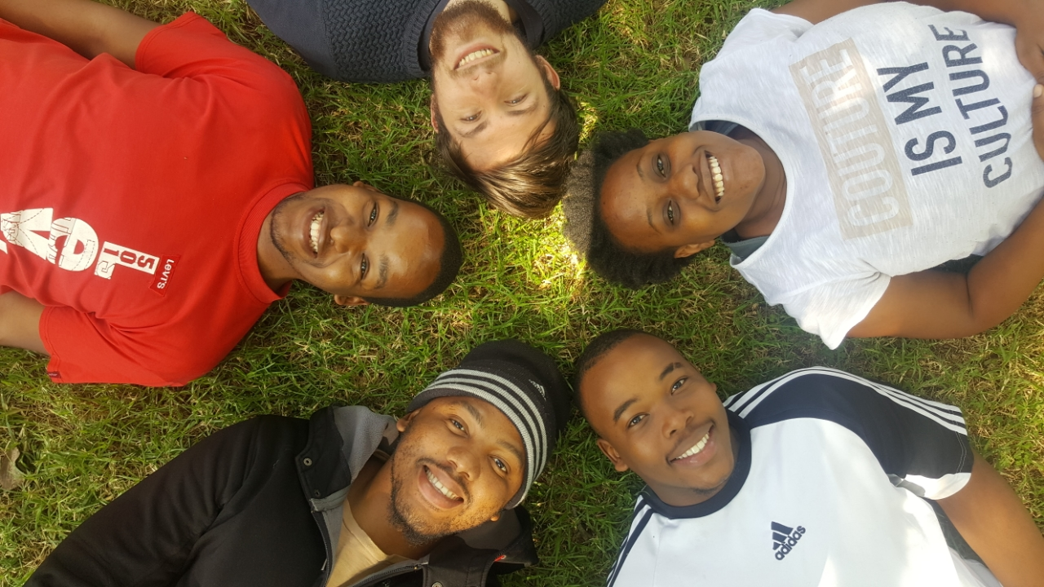
INDOOR MALL NAVIGATION
BRUTE FORCE

Slide 2

ROLES OF TEAM MEMBERS
THOMAS HONIBALL (Group Leader):
Unit testing
Integration testing
- Database setup
THABO NTSOANE:
Development
Documentation
Expo Setup (UI)
MPHO MASHABA:
Development
Documentation
- Project Management (Zenhub)
MUNYADZIWA TSHISIMBA:
Development
Documentation
Research
BANDILE DLAMINI:
Documentation
Development
Research

Slide 3
TEAM SCHEDULING AND PLANNING
Planning and Admin Meetings – twice a week Monday (14:30-15:00) and Friday (16:30 – 17:00)
Team Coding Sessions – Monday (15:00-16:30) and Friday (14:00 – 15:30)
The team has resolved to this solution to assist in collaboration and general team problem solving

Slide 4
PROJECT DESCRIPTION
Create a fully interactive mall guide of sorts which will allow users to easily find shops as well as act as a shopping companion, providing a list of available specials within a store based on location as well as allowing users to add items to a shopping cart to purchase and have delivered later. This system also aims to replace electronic maps using augmented reality to guide users to a selected store.

Slide 5
TECHNOLOGIES USED
EXPO – Testing implementation
REACT NATIVE - implementation
ZENHUB – Project Management tool
JEST – Integration testing
TRAVIS-CI – integration testing
SQLite – Database Manager

Slide 6
System Type
Interactive System – User Application
Event-Driven – Change in beacon ranges provide state changes that alter the system output

Slide 7
System Architecture
Client-Server - Main System (Client: Indoor Mall Navigation Application, Server: Database Management System)
Micro-services – Each Client (Application)
MVC – Micro-services Provided by Each Client
Object-Persistence Framework – Database Management System

Slide 8
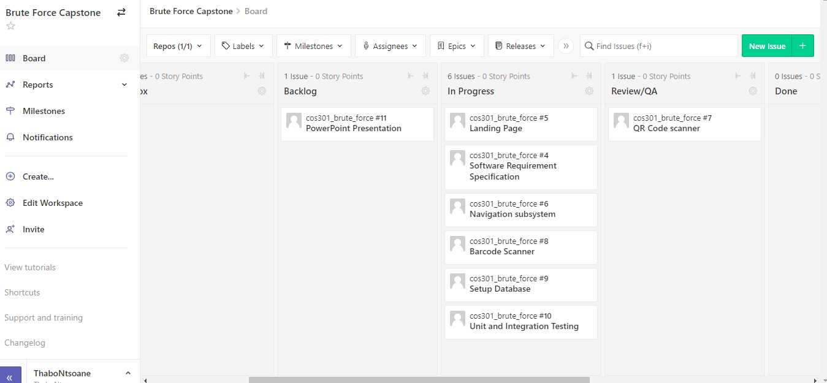
PROJECT MANAGEMENT TOOL
WE USED ZENHUB AS OUR PMT BY CREATING ISSUES THAT NEED TO BE RESOLVED

Slide 9
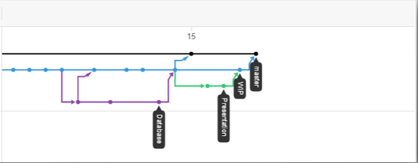
GIT STRUCTURE

